Slide 1

Drowsiness detector with alarm for drivers
Arnav Singh

Slide 2
The Problem Statement
The Drowsiness Detector with Alarm for drivers project aims to address the serious issue of drowsy driving, which poses a threat to road safety. Drowsy driving is a leading cause of motor vehicle crashes, injuries, and fatalities. The project seeks to develop a machine learning-based drowsiness detection system that can accurately identify the early signs of drowsiness or fatigue in drivers. By alerting drivers when he/she feel drowsy, the system can help prevent accidents and potentially save lives. The goal of this project is to improve road safety by developing an effective and reliable drowsiness detection system for drivers.

Slide 3
A real-life example
Imagine driving on a long stretch of highway, feeling your eyelids getting heavier by the minute. Suddenly, a warning message pops up on the dashboard, and an alarm sounds, alerting you that you're becoming drowsy. You adjust your posture, take a deep breath, and continue driving more alertly, knowing that you've just avoided a potential accident. This is the power of the drowsiness detection project - a simple yet effective program that helps to prevent accidents caused by drowsy driving.

Slide 4
The same happened with Rishabh Pant

Slide 5
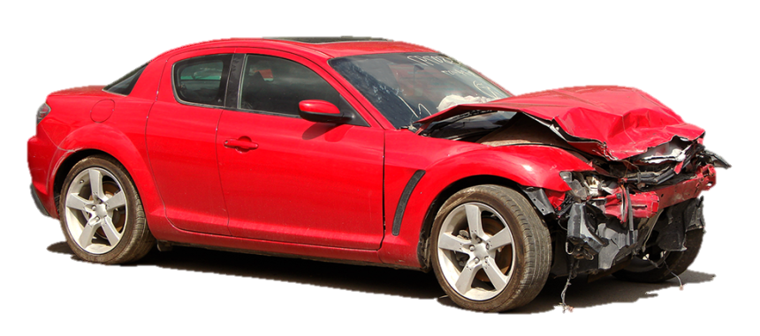
About 40% of road accidents that happen in India are due to Drowsy Driving!

Slide 6
Methodology
The program uses a computer camera to monitor a driver's face for signs of drowsiness. It analyses the driver's eyes and tracks their movement using machine learning algorithms. If the program detects that the driver's eyes are closed for a prolonged period or are exhibiting signs of fatigue, it triggers an alarm, displays a warning message, and sends an email to report the driver's behaviour. The program continues to monitor the driver's face until the driver stops the program or closes the camera window.

Slide 7
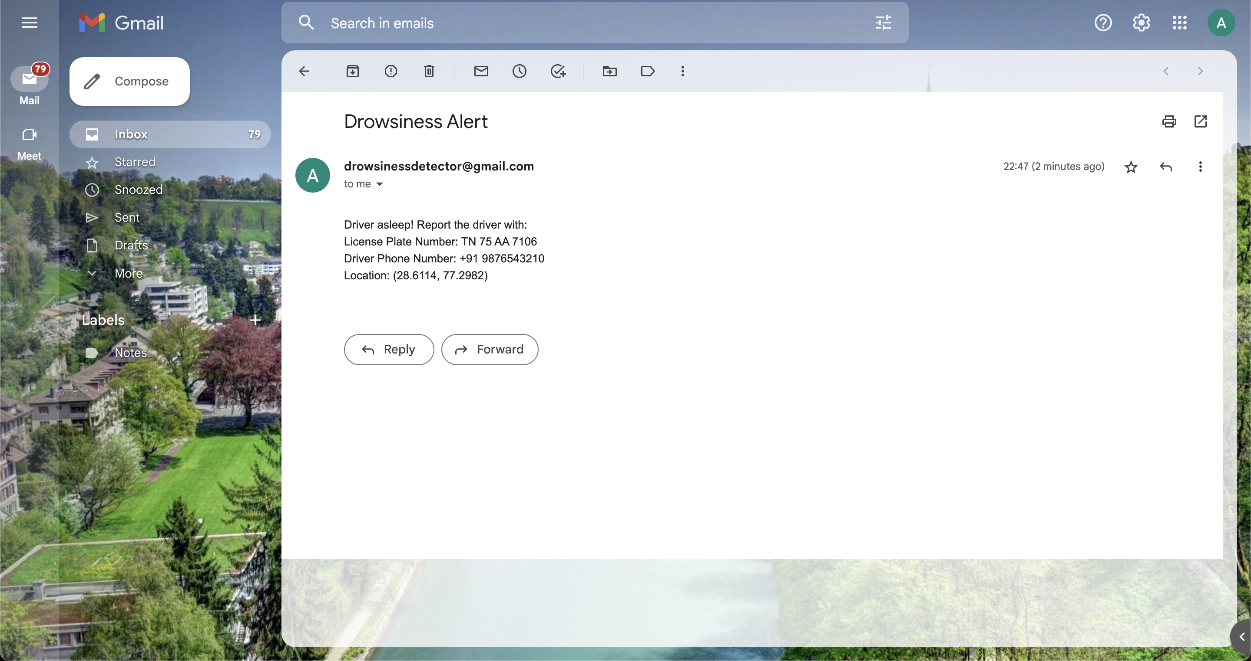
The Mail

Slide 8
LIVE DEMO

Slide 9
Its advantages
The advantages of this drowsiness detection project are:
Increased road safety: By alerting drivers when they are becoming drowsy, this project can help prevent accidents caused by drowsy driving, potentially saving lives and preventing injuries.
Easy to use: The program can be easily installed on any computer with a camera, making it a convenient and accessible solution for monitoring driver drowsiness.
Customizable: The program can be customized to fit different use cases and requirements, such as adjusting the duration of eye closure to trigger the alarm or adjusting the warning message's content. This flexibility makes it adaptable to a variety of situations and applications.

Slide 10
Contributions to the society
This drowsiness detection project can contribute to society by helping to reduce the number of accidents caused by drowsy driving, which can save lives and prevent injuries. It could also increase public awareness of the dangers of drowsy driving and encourage safer driving habits. Overall, this project has the potential to improve road safety and promote safer transportation practices.

